Slide 1
Continuous Random Variables

Slide 2
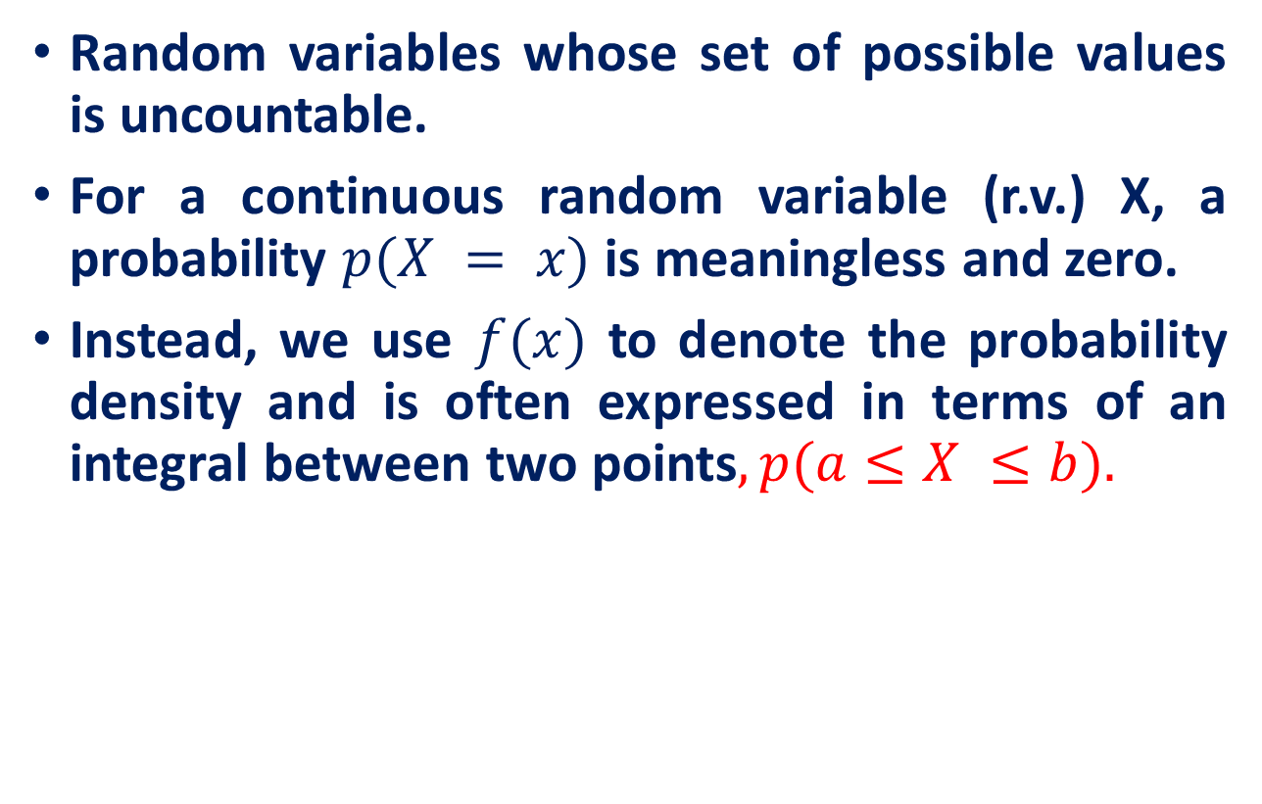
Continuous Random Variables
Random variables whose set of possible values is uncountable.
For a continuous random variable (r.v.) X, a probability $p(X = x)$is meaningless and zero.
Instead, we use $f(x)$ to denote the probability density and is often expressed in terms of an integral between two points$, p(a≤X ≤b).$

Slide 3
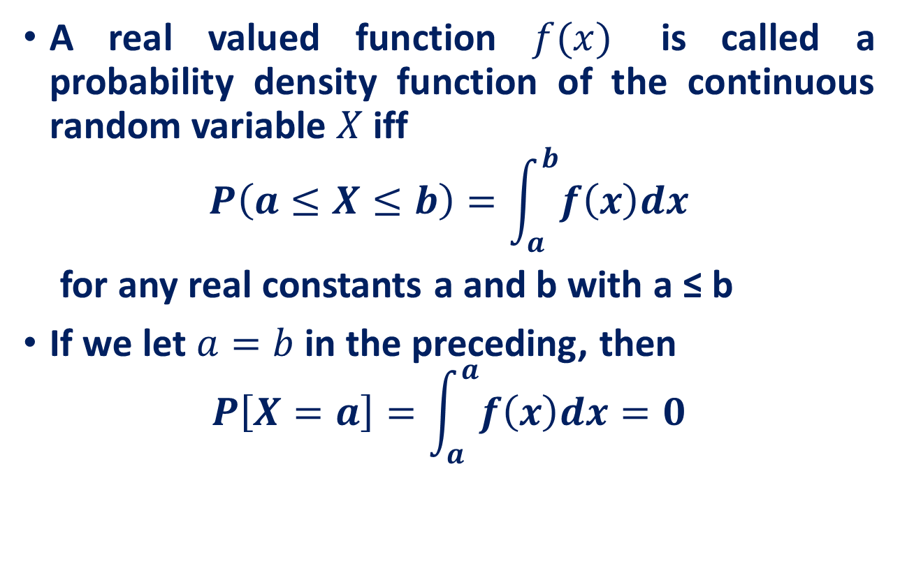
Continuous Random Variables
A real valued function $f(x)$ is called a probability density function of the continuous random variable $X$ iff
$$P\left(a≤X≤b\right)=\int_{a}^{b}{f\left(x\right)dx}$$
for any real constants a and b with a ≤ b
If we let $a=b$in the preceding, then
$$P\left[X=a\right]=\int_{a}^{a}{f\left(x\right)dx}=0$$
this equation states that the probability that a continuous random variable will assume any particular value is zero.

Slide 4
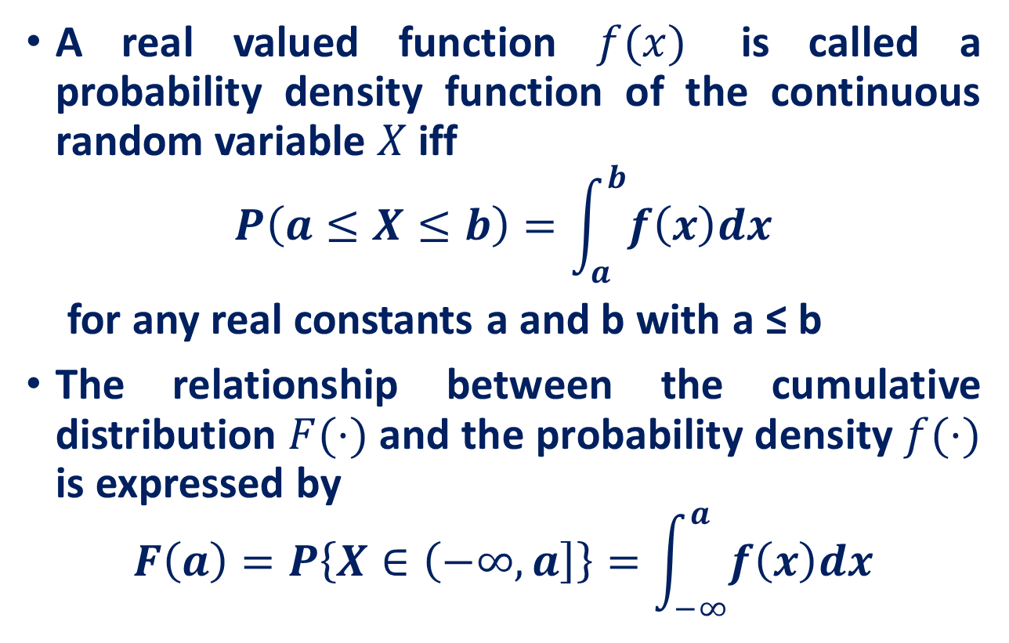
Continuous Random Variables
A real valued function $f(x)$ is called a probability density function of the continuous random variable $X$ iff
$$P\left(a≤X≤b\right)=\int_{a}^{b}{f\left(x\right)dx}$$
for any real constants a and b with a ≤ b
The relationship between the cumulative distribution $F(·)$and the probability density $f(·)$ is expressed by
$$F\left(a\right)=P\left\{X∈\left(−∞,a\right]\right\}=\int_{−∞}^{a}{f\left(x\right)dx}$$

Slide 5

Continuous Random Variables
Theorem: A function can serve as a probability density function of a continuous random variable X if its values f(x) satisfy the conditions
$f\left(x\right)≥0 for −∞<X<∞$
$\int_{−∞}^{∞}{f\left(x\right)dx}=1$

Slide 6
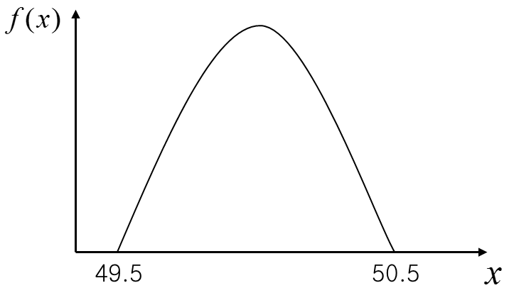
Continuous Random Variables
Example: Metal Cylinder Production
Suppose that the random variable x is the diameter of a randomly chosen cylinder manufactured by the company. Since this random variable can take any value between 49.5 and 50.5, it is a continuous random variable.
Suppose that the diameter of a metal cylinder has a p.d.f
Is this valid p.d.f.?

Slide 7
Continuous Random Variables

Slide 8
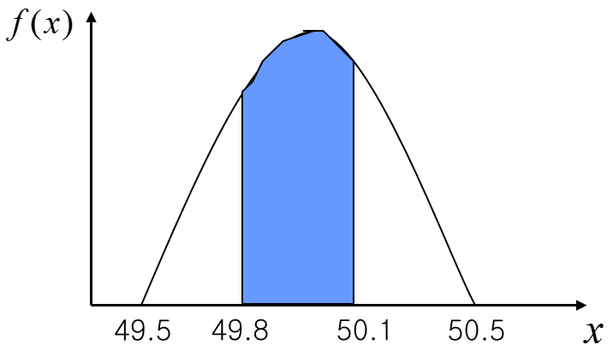
Continuous Random Variables
The probability that a metal cylinder has a diameter between 49.8 and 50.1 mm can be calculated to be

Slide 9
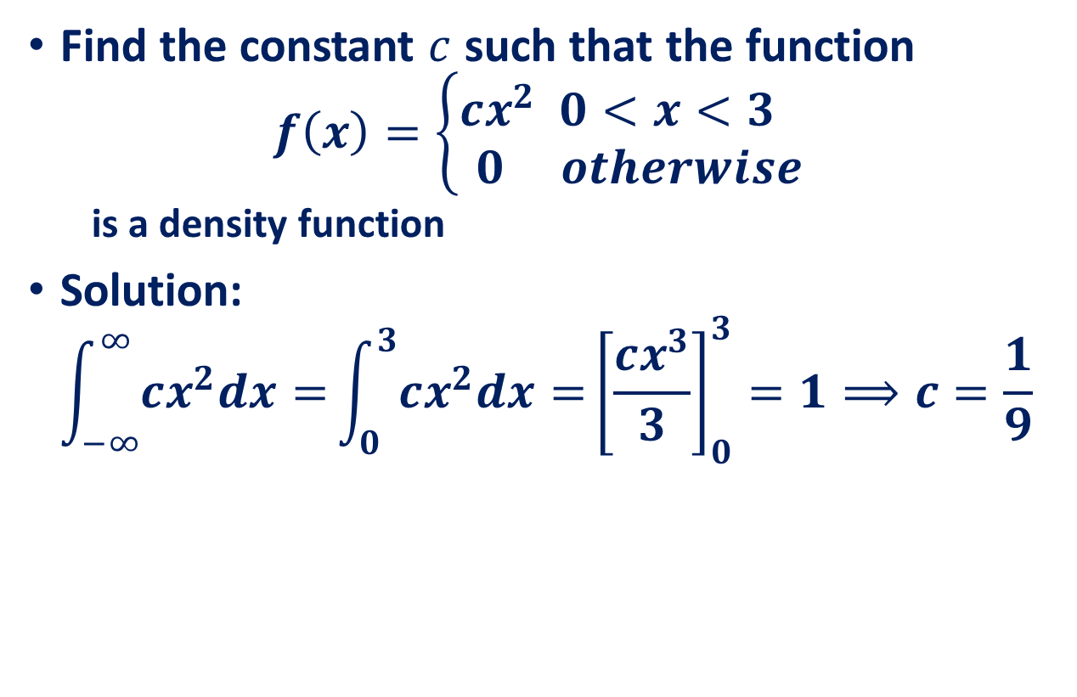
Continuous Random Variables
Find the constant $c$ such that the function
$$f\left(x\right)=\left\{\begin{aligned}cx^{2} 0<x<3 \\ 0 otherwise\end{aligned}\right.$$
is a density function
Solution:
$$\int_{−∞}^{∞}{cx^{2}dx=}\int_{0}^{3}{cx^{2}dx=}{\left[\frac{cx^{3}}{3}\right]}_{0}^{3}=1⟹c=\frac{1}{9}$$

Slide 10

Continuous Random Variables
Theorem: If X is a continuous random variable and a and b are real constants with a ≤ b, then
$$P(a≤X≤b)=P(a<X≤b)=P(a≤X<b) =P(a<X<b)$$
In case f(x) is continuous, the probability that X is equal to any particular value is zero.

Slide 11

Cumulative Distribution Function
Definition: If X is a continuous random variable with pdf $f(x)$, then the distribution function of $X$ is given by
$$F\left(a\right)=P\left(X≤a\right)=\int_{−∞}^{a}{f\left(x\right)dx}$$

Slide 12
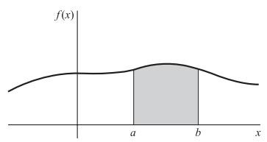
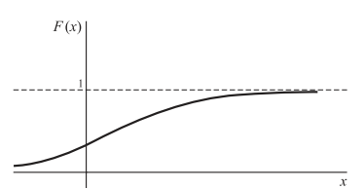
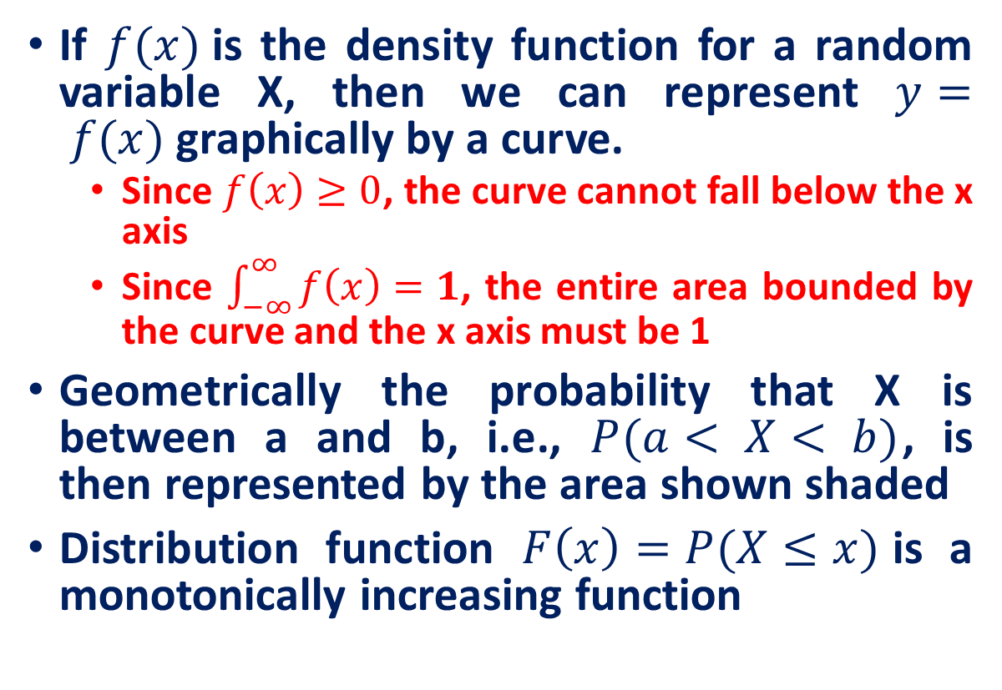
Graphical Interpretations
If $f(x)$is the density function for a random variable X, then we can represent $y= f(x)$graphically by a curve.
Since $f\left(x\right)≥0$, the curve cannot fall below the x axis
Since $\int_{−∞}^{∞}{f\left(x\right)}=1$, the entire area bounded by the curve and the x axis must be 1
Geometrically the probability that X is between a and b, i.e., $P(a< X< b)$, is then represented by the area shown shaded
Distribution function $F\left(x\right)=P(X≤x)$is a monotonically increasing function

Slide 13
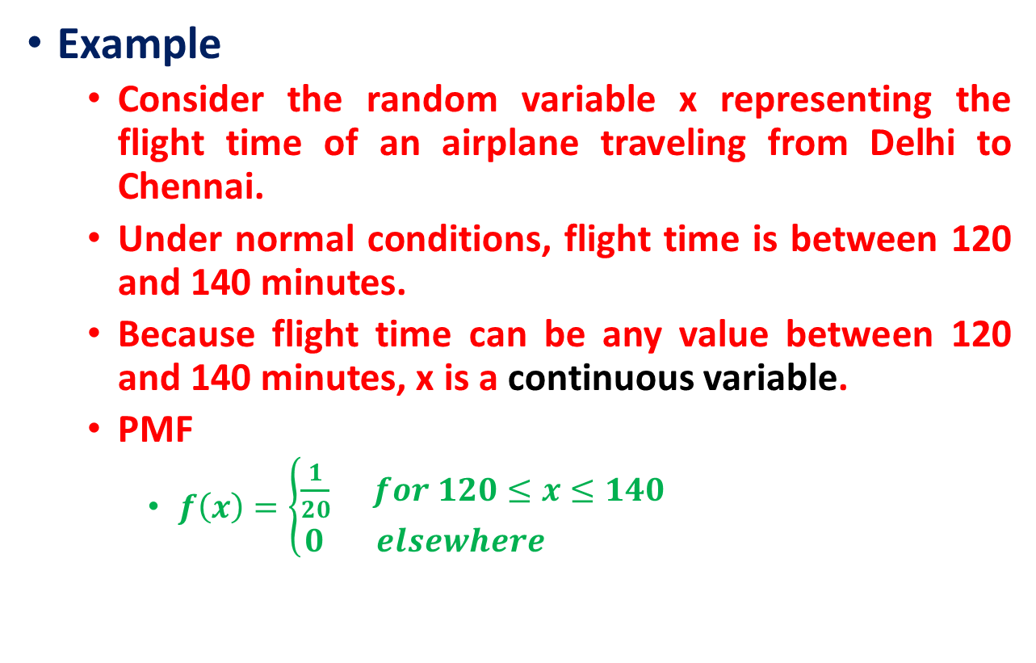
The Uniform Random Variable
Example
Consider the random variable x representing the flight time of an airplane traveling from Delhi to Chennai.
Under normal conditions, flight time is between 120 and 140 minutes.
Because flight time can be any value between 120 and 140 minutes, x is a continuous variable.
PMF
$f\left(x\right)=\left\{\begin{aligned}\frac{1}{20} for 120≤x≤140 \\ 0 elsewhere \end{aligned}\right.$
With every one-minute interval being equally likely, the random variable x is said to have a uniform probability distribution
https://www.probabilitycourse.com/chapter4/4_2_1_uniform.php

Slide 14
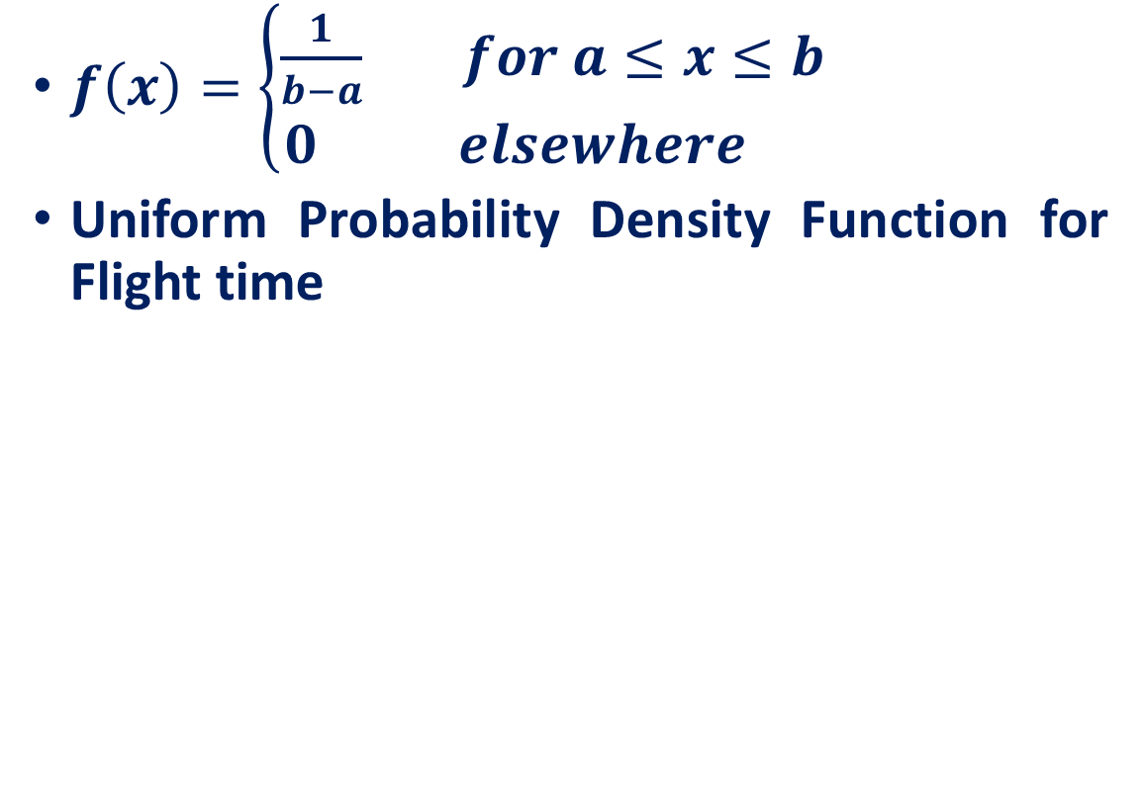
The Uniform Random Variable
$f\left(x\right)=\left\{\begin{aligned}\frac{1}{b−a} for a≤x≤b \\ 0 elsewhere \end{aligned}\right.$
Uniform Probability Density Function for Flight time
The shaded area indicates the probability the flight will arrive in the interval between 120 and 140 minutes
120
125
130
135
140

Slide 15
Probability as an Area
Question: What is the probability that arrival time will be between 120 and 130 minutes—that is:
10
120
125
130
135
140

Slide 16
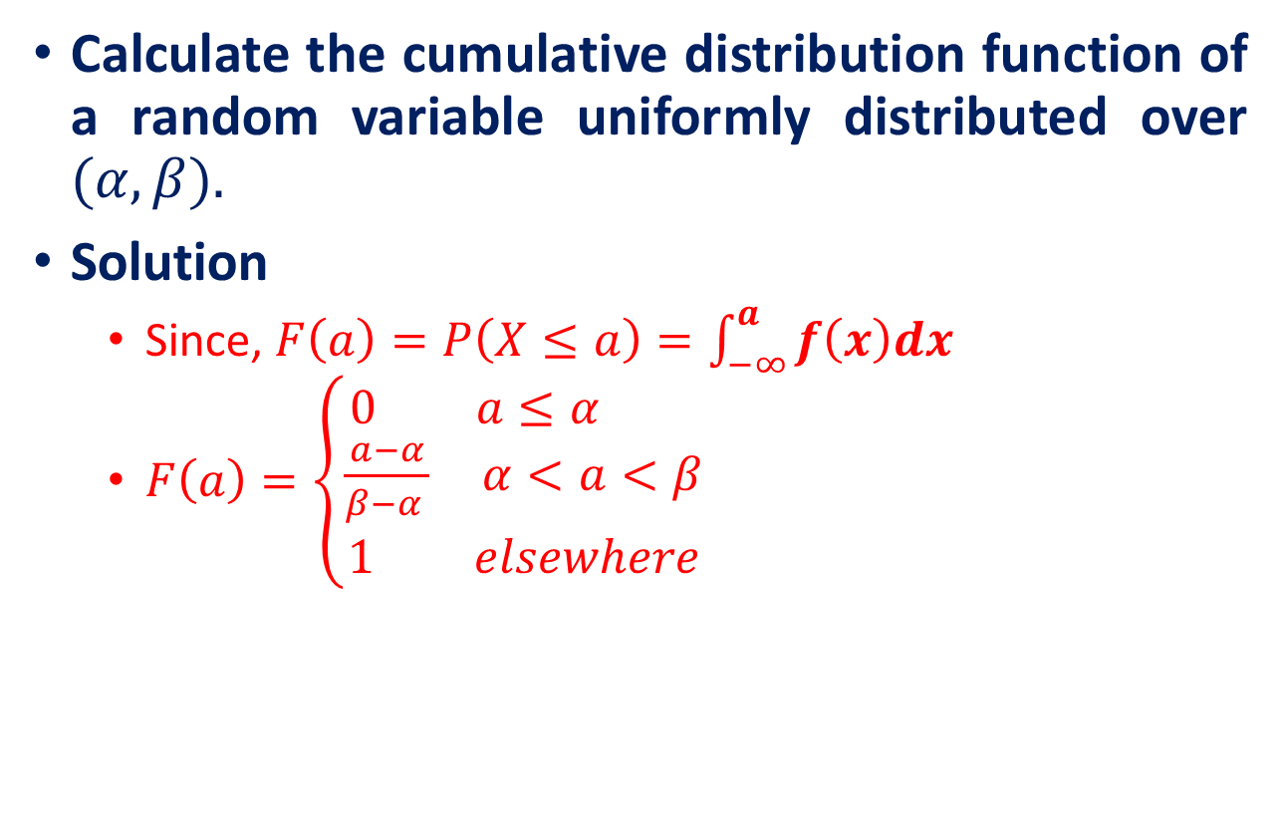
The Uniform Random Variable
Calculate the cumulative distribution function of a random variable uniformly distributed over $(α, β).$
Solution
Since, $F\left(a\right)=P\left(X≤a\right)=\int_{−∞}^{a}{f\left(x\right)dx}$
$F\left(a\right)=\left\{\begin{aligned}0 a≤α \\ \frac{a−α}{β−α } α<a<β \\ 1 elsewhere\end{aligned}\right.$

Slide 17
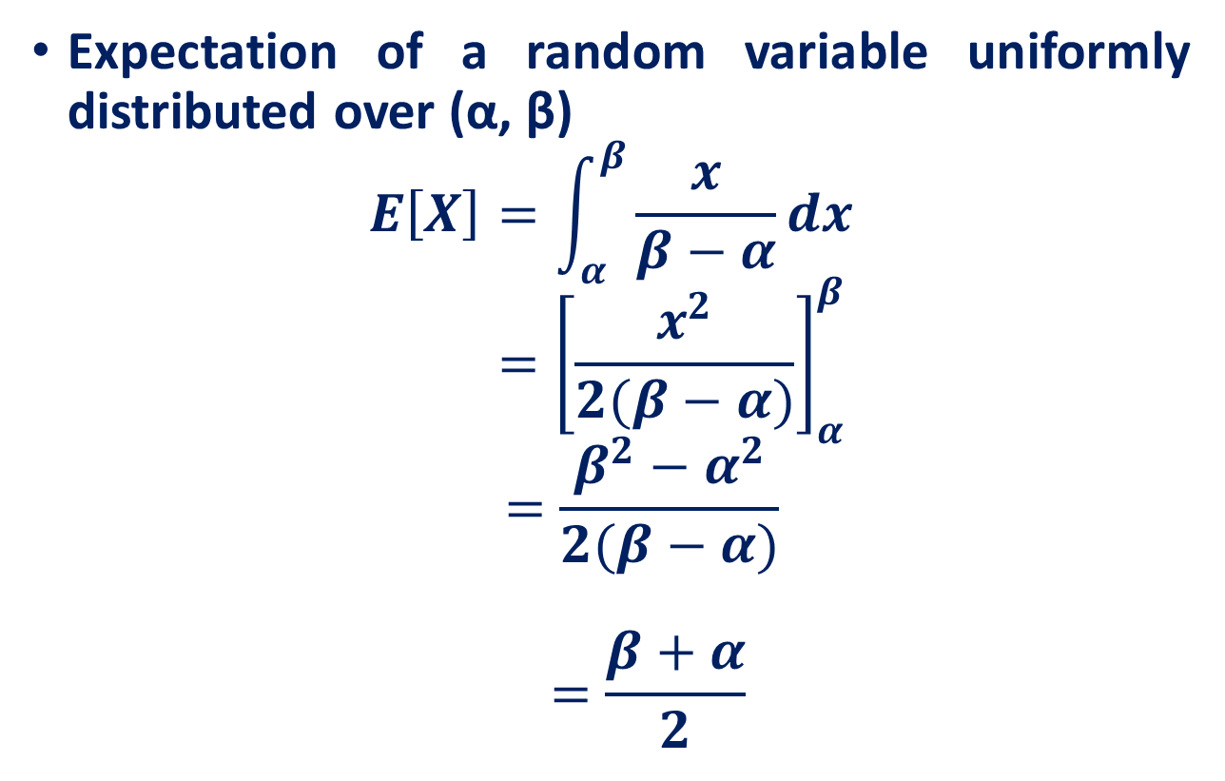
Expectation of a Uniform Random Variable
Expectation of a random variable uniformly distributed over (α, β)
$$E\left[X\right]=\int_{α}^{β}{\frac{x}{β−α}dx}$$
$${ =\left[\frac{x^{2}}{2(β−α)}\right]}_{α}^{β}$$
$$=\frac{β^{2}−α^{2}}{2(β−α)}$$
$$=\frac{β+α}{2}$$

Slide 18
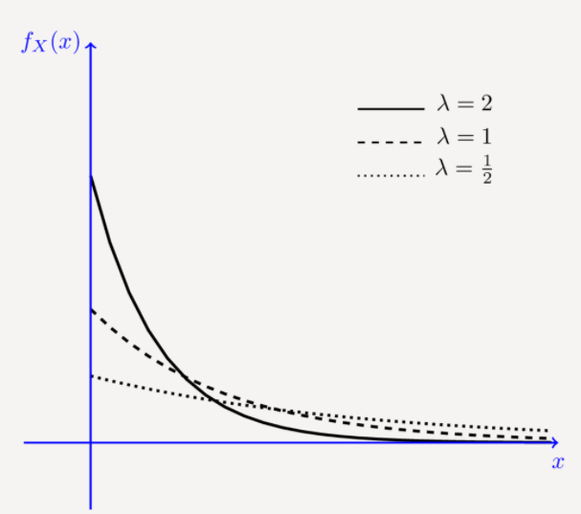
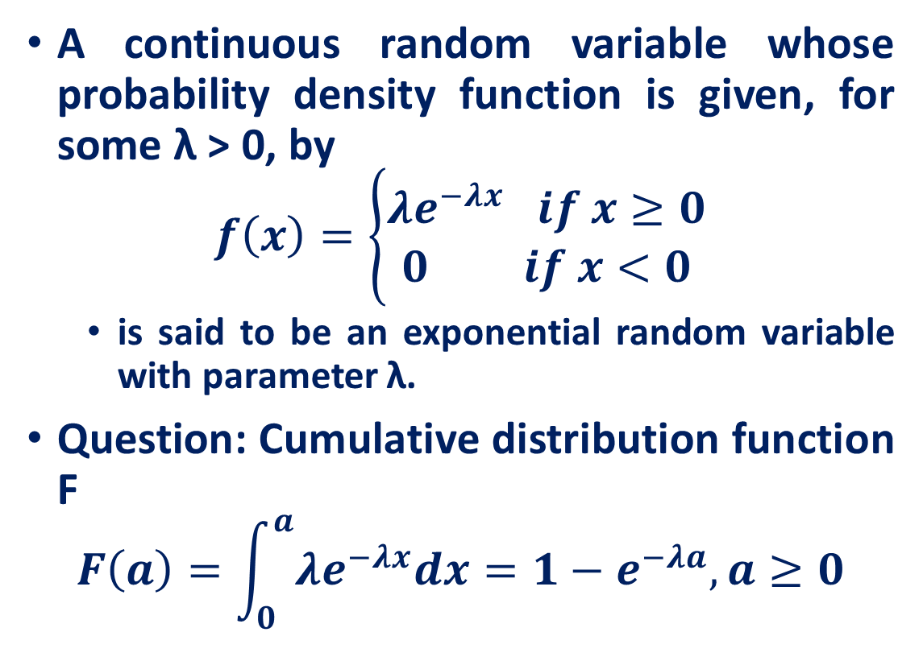
Exponential Random Variables
A continuous random variable whose probability density function is given, for some λ > 0, by
$$f\left(x\right)=\left\{\begin{aligned}λe^{−λx} if x≥0 \\ 0 if x<0\end{aligned}\right.$$
is said to be an exponential random variable with parameter λ.
Question: Cumulative distribution function F
$$F\left(a\right)=\int_{0}^{a}{λe^{−λx}dx}=1−e^{−λa}, a≥0$$
https://www.probabilitycourse.com/chapter4/4_2_2_exponential.php

Slide 19
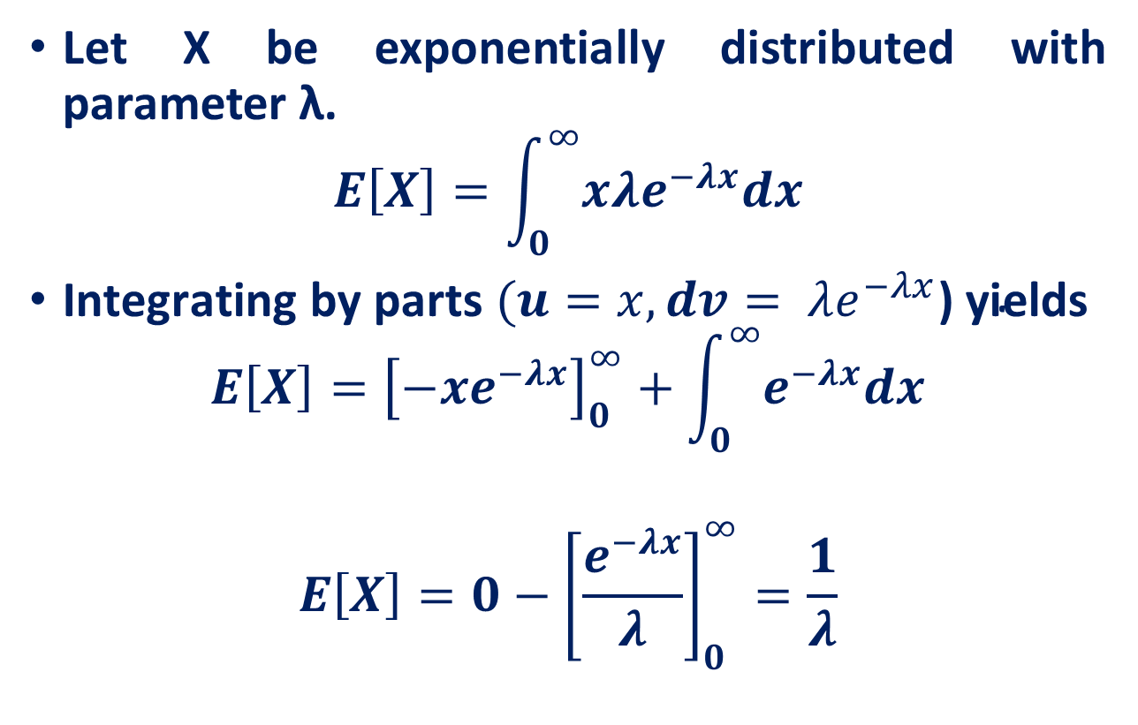
Expectation of Exponential Random Variable
Let X be exponentially distributed with parameter λ.
$$E\left[X\right]=\int_{0}^{∞}{x{λe}^{−λx}dx}$$
$\text{Integrating} \text{by} \text{parts} (u=x,dv= λe^{−λx}\text{)} \text{yields}$
$$E\left[X\right]={\left[−xe^{−λx}\right]}_{0}^{∞}+\int_{0}^{∞}{e^{−λx}dx}$$
$$E\left[X\right]=0−{\left[\frac{e^{−λx}}{λ}\right]}_{0}^{∞}=\frac{1}{λ}$$

Slide 20
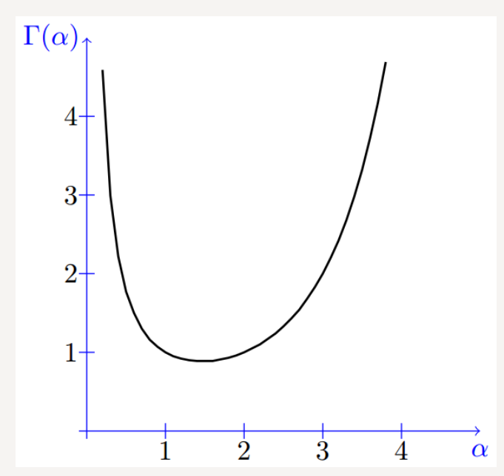
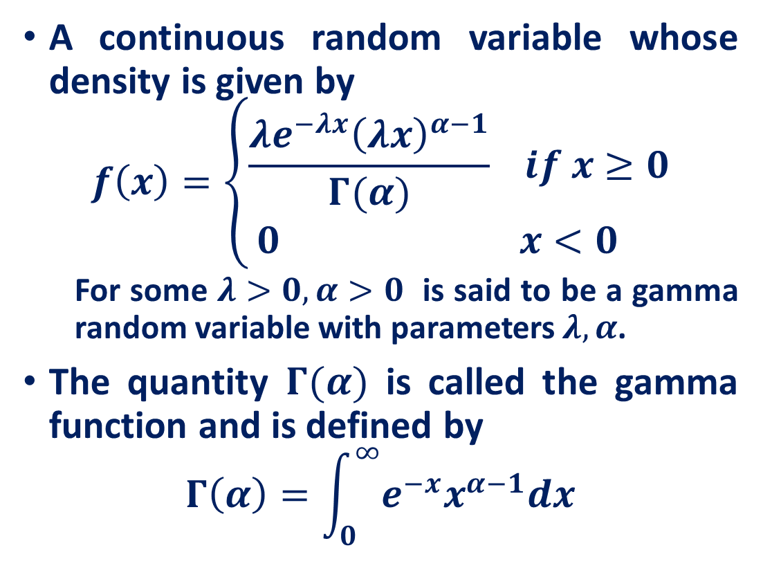
Gamma Random Variables
A continuous random variable whose density is given by
$$f\left(x\right)=\left\{\begin{aligned}\frac{λe^{−λx}{\left(λx\right)}^{α−1}}{Γ(α)} if x≥0 \\ 0 x<0 \end{aligned}\right.$$
For some $λ>0, α>0$ is said to be a gamma random variable with parameters $λ, α$.
The quantity $Γ(α)$ is called the gamma function and is defined by
$$Γ\left(α\right)=\int_{0}^{∞}{e^{−x}x^{α−1}dx}$$
https://www.probabilitycourse.com/chapter4/4_2_4_Gamma_distribution.php

Slide 21
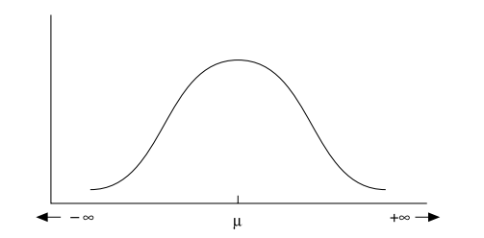
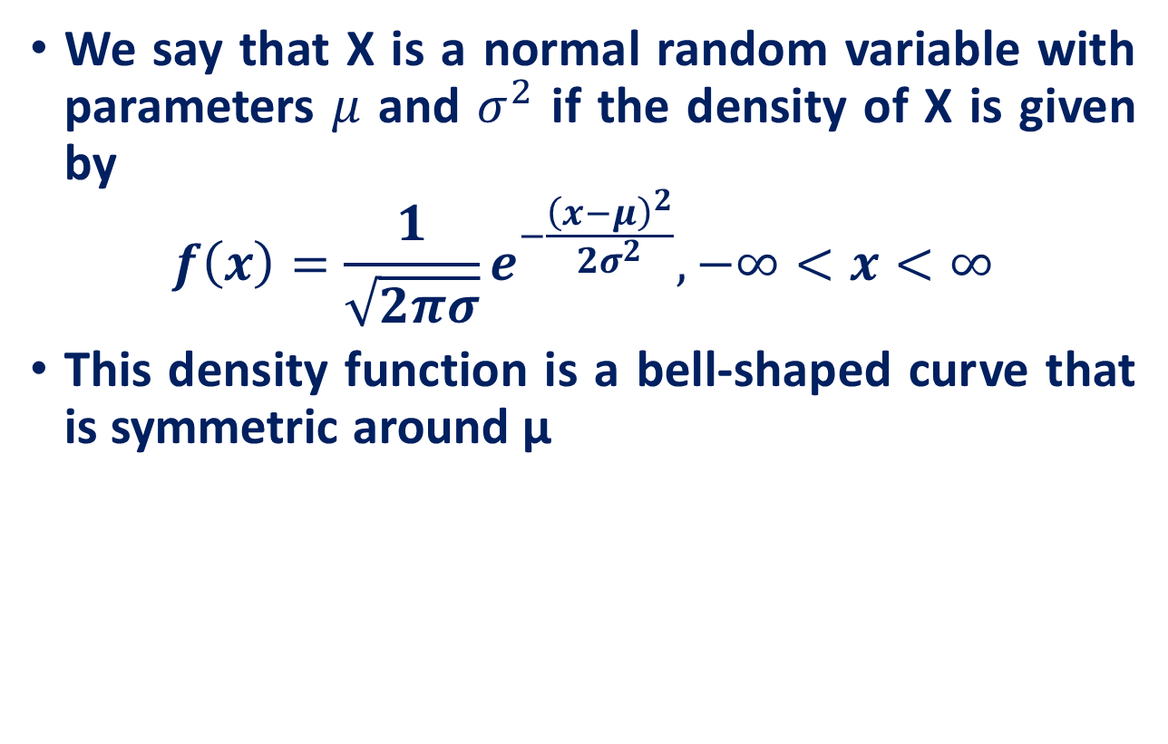
Normal Random Variables
We say that X is a normal random variable with parameters $μ$ and $σ^{2}$ if the density of X is given by
$$f\left(x\right)=\frac{1}{\sqrt{2πσ}}e^{−\frac{{\left(x−μ\right)}^{2}}{2σ^{2}}}, −∞<x<∞$$
This density function is a bell-shaped curve that is symmetric around μ
https://www.probabilitycourse.com/chapter4/4_2_3_normal.php

Slide 22
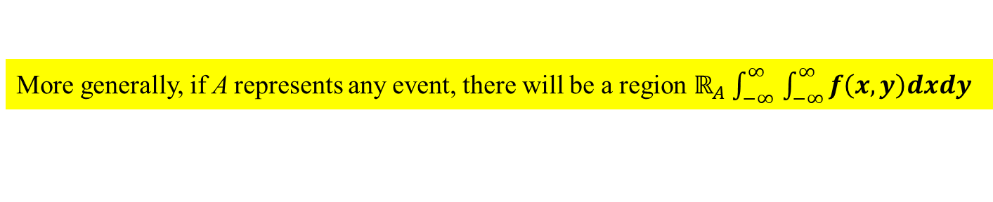
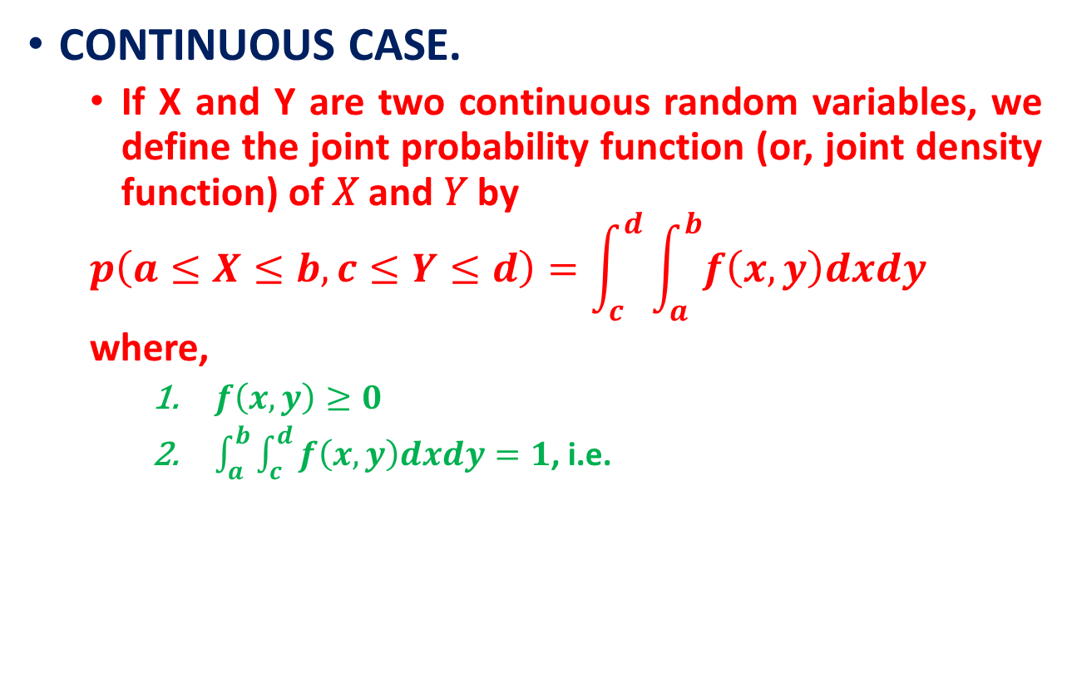
Joint Distributions
CONTINUOUS CASE.
If X and Y are two continuous random variables, we define the joint probability function (or, joint density function) of 𝑋 and 𝑌 by
$$p\left(a≤X≤b, c≤Y≤d\right)=\int_{c}^{d}{\int_{a}^{b}{f\left(x,y\right)dxdy}}$$
where,
$f\left(x,y\right)≥0$
$\int_{a}^{b}{\int_{c}^{d}{f\left(x,y\right)dxdy}}=1$, i.e.
More generally, if A represents any event, there will be a region $ℝ_{A}$ $\int_{−∞ }^{∞}{\int_{−∞}^{∞}{f\left(x,y\right)dxdy}}$

Slide 23

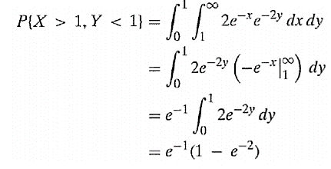

Joint Distributions
The joint density function of X and Y is given by
Compute $P\{X>1,Y<1\}$

Slide 24
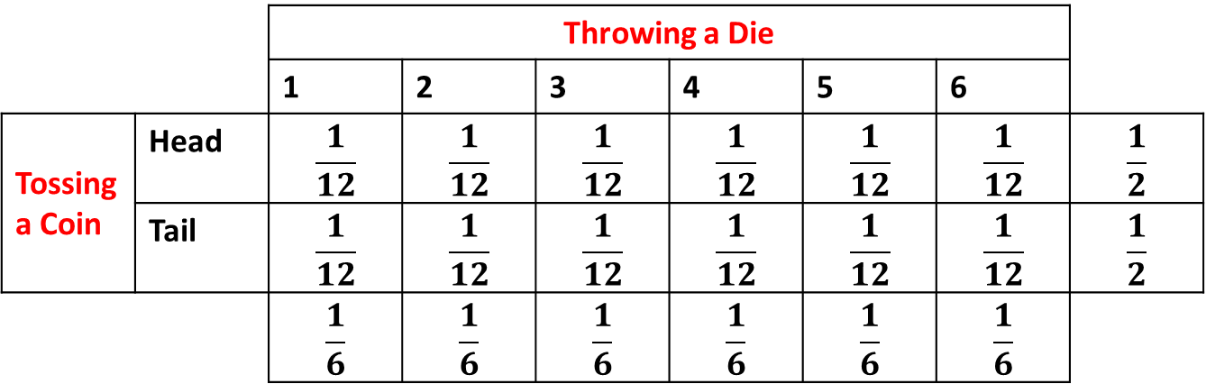

Joint Distributions
DISCRETE CASE
If X and Y are two discrete random variables, we define the joint probability function of $X$ and $Y$ by
$$P\left(X= x, Y= y\right)=f(x, y)$$
where,
$f\left(x,y\right)≥0$
$\sum_{x}{\sum_{y}{f\left(x,y\right)=1}}$, i.e., the sum over all values of x and y is 1.
Can be represented by a joint probability table
 |  | Throwing a Die
 |  | 1 | 2 | 3 | 4 | 5 | 6
Tossing a Coin | Head | $$\frac{1}{12}$$ | $$\frac{1}{12}$$ | $$\frac{1}{12}$$ | $$\frac{1}{12}$$ | $$\frac{1}{12}$$ | $$\frac{1}{12}$$ | $$\frac{1}{2}$$
 | Tail | $$\frac{1}{12}$$ | $$\frac{1}{12}$$ | $$\frac{1}{12}$$ | $$\frac{1}{12}$$ | $$\frac{1}{12}$$ | $$\frac{1}{12}$$ | $$\frac{1}{2}$$
 |  | $$\frac{1}{6}$$ | $$\frac{1}{6}$$ | $$\frac{1}{6}$$ | $$\frac{1}{6}$$ | $$\frac{1}{6}$$ | $$\frac{1}{6}$$
Joint probability
Marginal probability

Slide 25
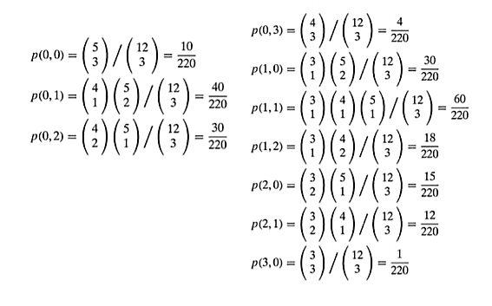
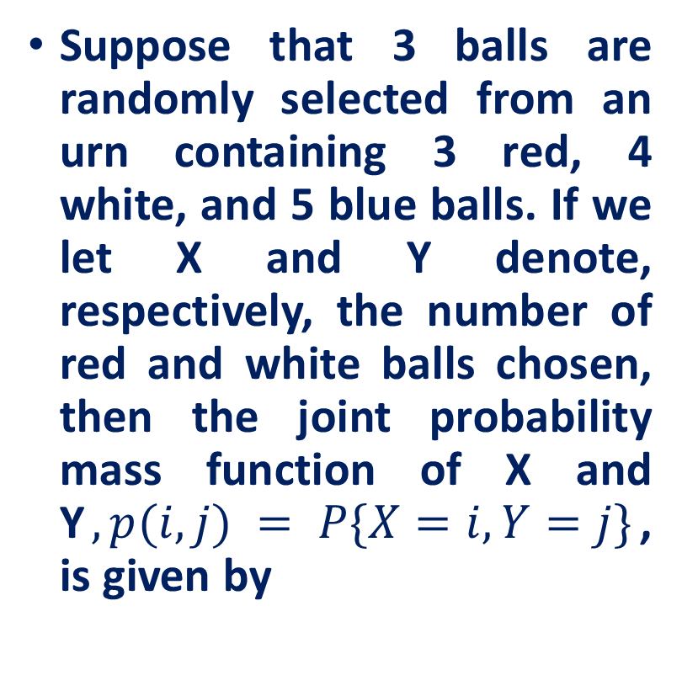
Joint Distributions
Suppose that 3 balls are randomly selected from an urn containing 3 red, 4 white, and 5 blue balls. If we let X and Y denote, respectively, the number of red and white balls chosen, then the joint probability mass function of X and Y$, p(i,j) = P\{X=i,Y=j\}$, is given by

Slide 26
Reference
Lecture notes on Probability Theory by Phanuel Mariano
Introduction to Probability Models, Sheldon M. Ross, Tenth Edition

